Slide 1


Slide 2
Warning
It is totally normal and okay to have moments where you understand nothing in this workshop :v

Slide 3
CONTENTS
01
Getting started with ESP32
02
Getting used to ESP-IDF
03
Connecting to WiFi
04
TCP/IP sockets

Slide 4
Session’s content:
Introduction to the ESP32 and its’ variants
Comparing ESP32 to Arduino UNO
Getting started with IoT Development Framework
Understand the “blink” example code

Slide 5
01
Getting Started with ESP32

Slide 6
Introduction
ESP32 is a low-cost dual core microcontroller developed by Espressif Systems. It has both WiFi and Bluetooth integrated with various peripherals.

Slide 7
ESP32 vs Arduino UNO
Specs | ESP32 | Arduino UNO
CPU | Dual Core 160 MHz | Single Core 16MHz
Flash Memory | 4MB | 32KB
SRAM | 520KB | 2KB
GPIOs | 38 | 20
WiFi/Bluetooth | Yes | No
UART (Hardware Serial) | 3 | 1
SPI | 3 | 1
I²C | 2 | 1
Operating Voltage | 3.3V | 5V
Price | 2500DA/ 3.5$ | 2800DA/ 4$

Slide 8
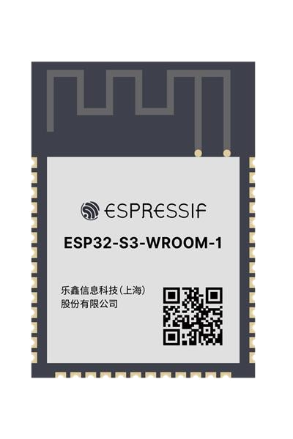
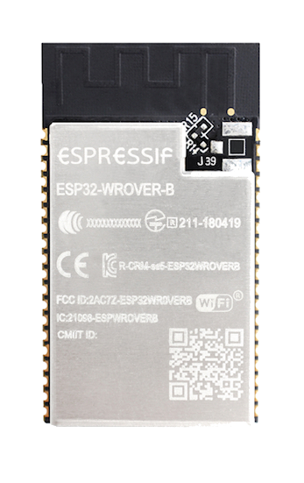
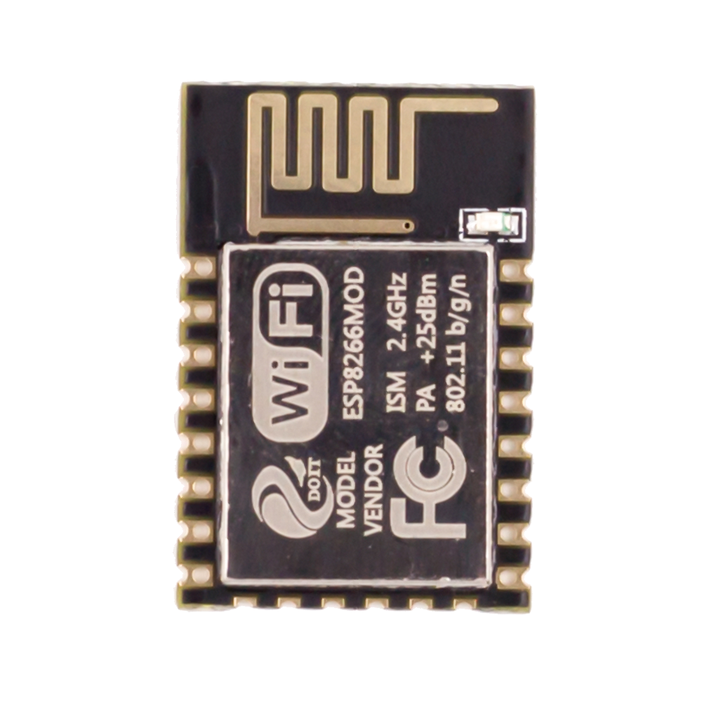
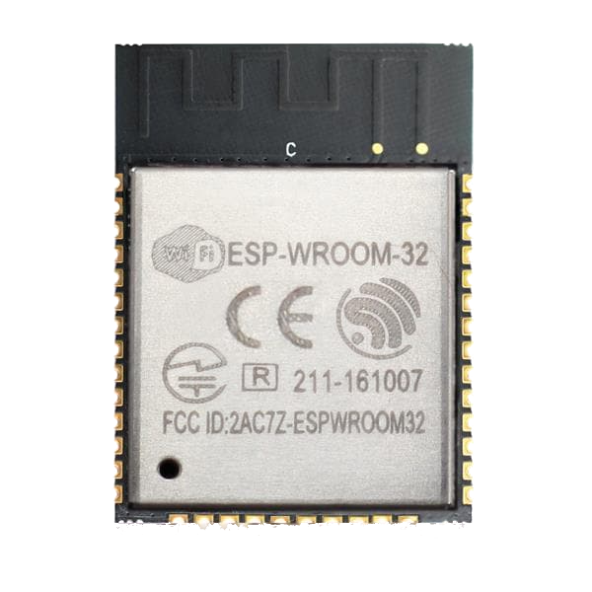
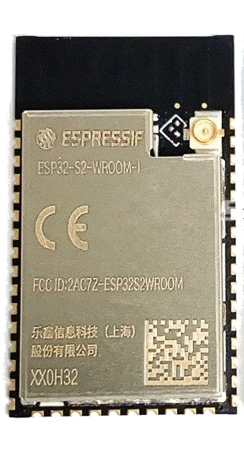
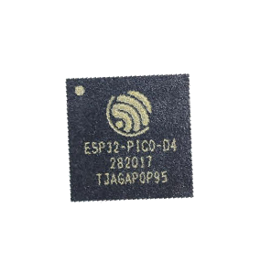
Other ESPs
ESP8266
ESP32 Wroom
ESP32 Wrover
ESP32-S2
ESP32 PICO D4
ESP32-S3

Slide 9
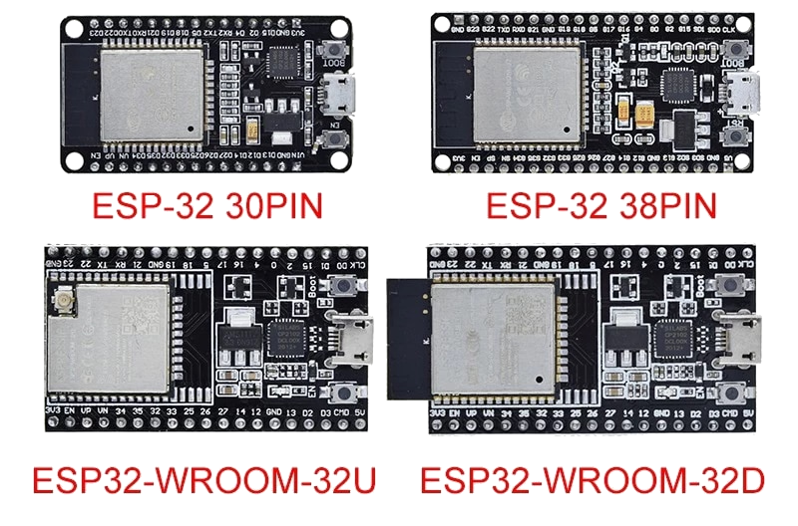
Developement boards

Slide 10
How to program the ESP32
Arduino Framework
IoT Dev Framework
micropython, lua...
Beginner friendly but thats it. Very limited, lacks many features and bad coding mindset (copy-paste)
Official framework supported by Espressif. Extremely reliable and configurable. Well documented with growing community.
Just do not use this.
You do not want a high level language when dealing with microcontrollers.
C/C++ is the way to go with embedded systems.

Slide 11
Setting up ESP-IDF
Install ESP-IDF with the esp-idf-tools-setup-offline-4.4.exe
Make sure the path you install esp-idf does not have space in it
Install VSCode
Install the Espressif IDF Extensions in VSCode
F1 or CTRL+Shift+P and search for “Configure ESP-IDF extension”
Choose “Use existing setup”

Slide 12
Your first ESP-IDF project
F1 or CTRL+Shift+P and search for “new project”
Set project name and directory then choose template
Pick the “blink” example as your project template

Slide 13
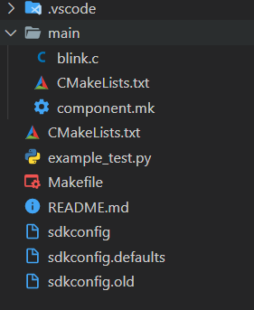
ESP-IDF Project Structure
main C file
build system related files
project configuration files

Slide 14
ESP-IDF Extension status bar
Port
Target platform
Menu Config
Build
Flash
Monitor
New IDF terminal
Project directory
Clean project
Build, Flash and Monitor

Slide 15
Arduino Framework vs ESP-IDF
Arduino | ESP-IDF
pinMode(pin, mode) | gpio_set_direction(pin, mode)
digitalWrite(pin, state) | gpio_set_level(pin, state)
Serial.printf() | printf()
delay() | vTaskDelay()
OUTPUT | GPIO_MODE_OUTPUT
INPUT | GPIO_MODE_INPUT

Slide 16
02
Getting used to ESP-IDF

Slide 17
Session’s content:
Understand the “Hello World” code example
Learn how to use the ESP-IDF documentation and ESP32 datasheet
Use “ESP_LOGx” instead of printf to make log statements
A bit on freeRTOS and menuconfig

Slide 18
Resources you need
Example codes: Example codes are the best way to understand how to use any feature of the ESP32
Source code of esp-idf: You can open the source code by right-clicking and click on “go to definition”
Docs: docs.espressif.com/projects/esp-idf/en/latest/esp32/api-reference/
Datasheet: https://www.espressif.com/sites/default/files/documentation/esp32-wroom-32_datasheet_en.pdf

Slide 19
Logging in general:
Log is outputting informations about a software or microcontroller to the console. This can be done using simple print statements. However, it gets really hard to debug big projects without organizing logs. One logging convention is to split your logs into 5 log levels: Verbose, Debug, Info, Warn, Error
 | Verbose Statement | Debug Statement | Info Statement | Warn Statement | Error Statement
Verbose Level | Included | Included | Included | Included | Included
Debug Level | Excluded | Included | Included | Included | Included
Info Level | Excluded | Excluded | Included | Included | Included
Warn Level | Excluded | Excluded | Excluded | Included | Included
Error Level | Excluded | Excluded | Excluded | Excluded | Included
Off | Excluded | Excluded | Excluded | Excluded | Excluded

Slide 20
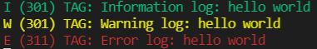
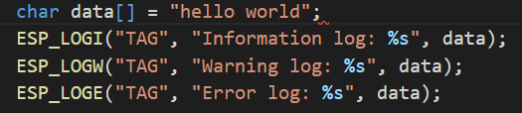
Logging in ESP-IDF:
Logs in ESP-IDF is achieved with esp_log.h library. The output has the following format:
Log Level (Time) TAG: Log Content
This is achieved with the following code

Slide 21
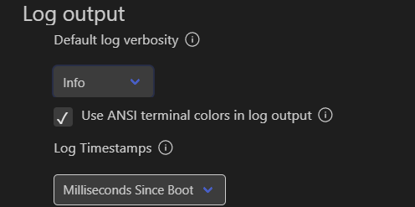
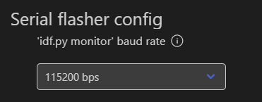
Introduction to MenuConfig:
MenuConfig is simply a configuration interface. You can find many options related to both the build system and esp-idf components. It can be accessed using the menuconfig icon in the status bar
One of the things you can with menuconfig is change settings related to the serial monitor of the esp-idf. You can change log settings like log level (default is INFO) or the baudrate (default is 115200)

Slide 22
Introduction to freeRTOS:
freeRTOS is one of the most popular real-time operating systems for embedded systems. It is used in 35 different microcontrollers. An operating system is used to manage the execution of processes and provides the necessary resources to them (memory and cpu-time).
One of the benefits of using freeRTOS is the ability of multi-threading in embedded systems. Multi-threading is essentially running two different piece of code (functions) in parallel. They are called tasks with each task have its own priority.

Slide 23
03
Connecting to WiFi

Slide 24
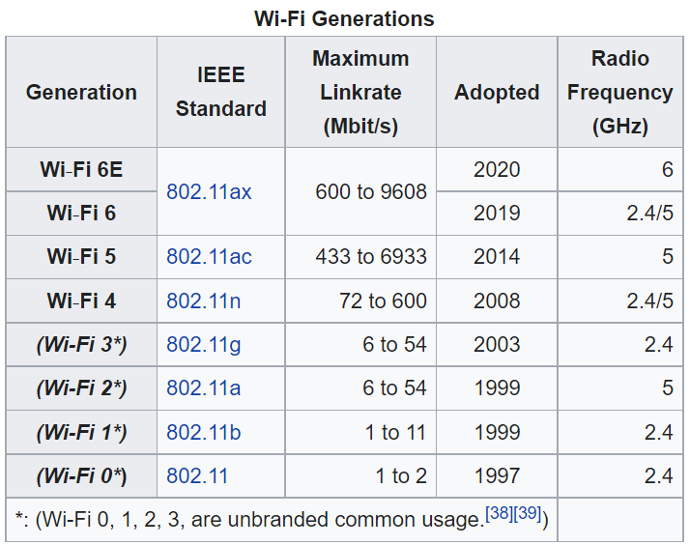
Wi-Fi Introduction
Wifi is a family of wireless network protocols, based on the IEEE 802.11 family of standards, allowing nearby digital devices to exchange data by radio waves.
Check Wikipedia for more

Slide 25
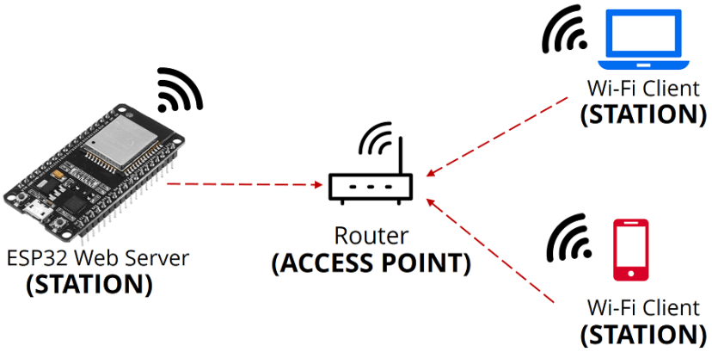
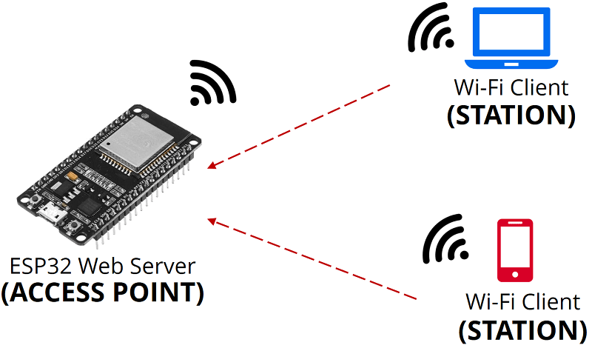
WiFi Operating mode
Station
softAP

Slide 26
WiFi Station Example
F1 or CTRL+Shift+P and search for “new project”
Set project name and directory then choose template
Pick the “station” example as your project template

Slide 27
WiFi softAP Example
F1 or CTRL+Shift+P and search for “new project”
Set project name and directory then choose template
Pick the “softAP” example as your project template

Slide 28
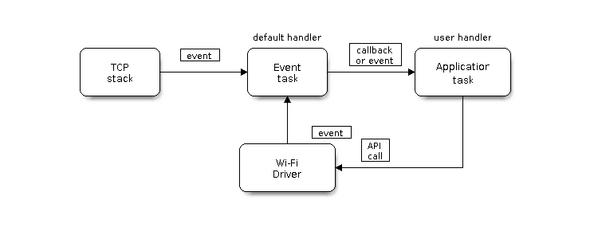
WiFi Events

Slide 29
04
TCP/IP

Slide 30
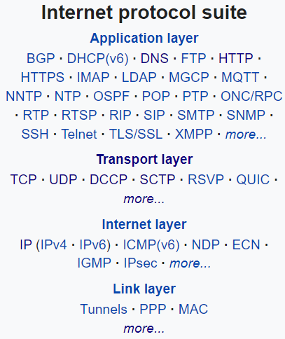
TCP/IP
TCP/IP (Transmission Control Protocol/Internet Protocol) is one of the main protocols of the Internet protocol suite. The Internet protocol suite specifies how data should be packetized, addressed, transmitted, routed, and received. This functionality is organized into four abstraction layers.
The IETF (Internet Engineering Task Force) is the organization that created and maintains the internet protocol suite.
Check Wikipedia for more

Slide 31
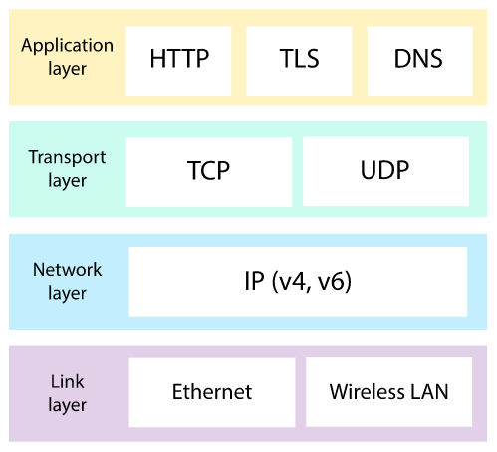
Layers of Internet protocol suite
A direct application of the transport layer protocols
Specifies how the communication between 2 devices should happen to ensure reliable transmission of packets
Specifies how packets are organized and makes sure they arrive at their destination.
Specifies how bits are sent between 2 devices
Khan Academy has good stuff on this

Slide 32
Why TCP/IP
TCP/IP allows reliable and simple communication between 2 devices. TCP provides accurate,ordered and error-checked stream of data. on the other hand, UDP is unordered and prone to packet losses but is faster compared to TCP.
In Internet of Things applications, we want to make sure that the data captured by our sensors is transmitted and stored correctly in databases.
If the data stream does not need to be reliable like video or audio streaming, UDP would be more suitable.

Slide 33
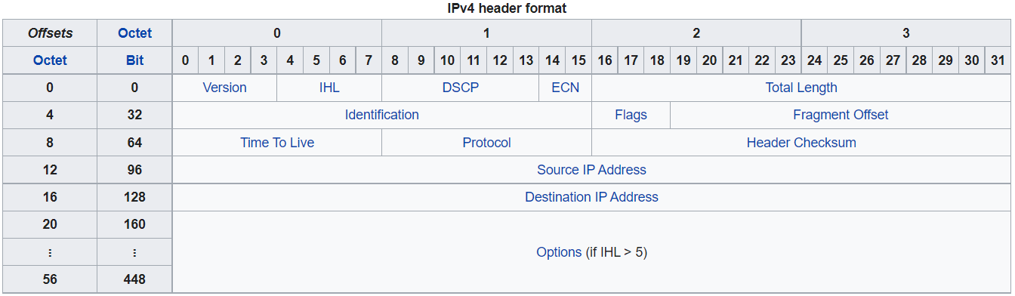
IP (Internel Protocol)
IP has the task of delivering packets from the source host to the destination host solely based on the IP addresses in the packet headers.
The most dominant version is IPv4 with the following packet structure
Check Wikipedia for more

Slide 34
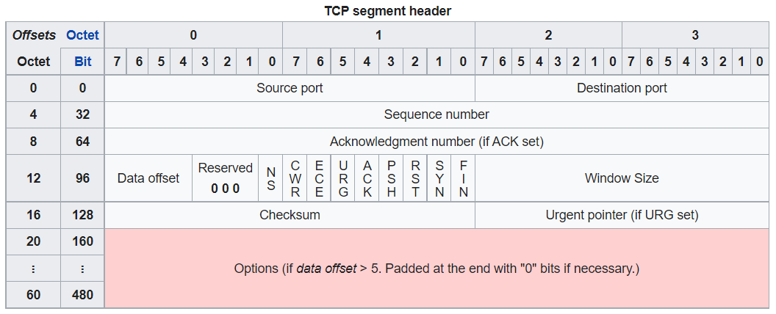
TCP (Transmission Control Protocol)
TCP has the task of making sure that packets are error-free and has not been lost. Extra informations is added in the packet header on top of IP header.
Check Wikipedia for more

Slide 35
Network Addresses
Each device connected to a network (LAN, Internet...etc) will get assigned an IP Address like the following example: 192.168.1.120
Each Device have to select a port from 0 to 65535 to set as a communication end-point. Ports can have a well-known function like port 80 for HTTP, 23 for SSH, 443 for HTTPS...etc.
Once the IP Address and Port are set for each device, connection can be established with

Slide 36
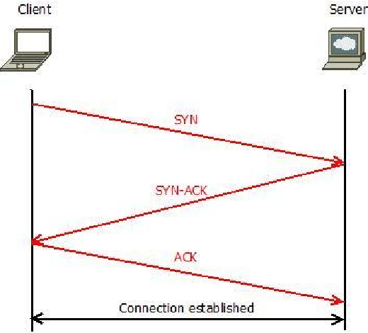
Connection 3-Way Handshake
Once the IP Address and Port are set for each device, connection can be established with the 3 way handshake

Slide 37
Socket Programming
Socket programming is basically the implementation of the internet protocol suite.
A socket is an end-point of communication that has both IP address and port number. Sockets can be both clients and servers, their main functions are:
Client (initiator):
connect(socket_address)
send(data)
data = recv()
close()
Server (acceptor):
bind(socket_address)
listen()
accept()
send(data)
data = recv()
close()

Slide 38
Socket Programming
Sockets are universal across all platforms and programming languages. The same sockets functions can be found in python, C/C++, Java, Javascript...etc
Sockets are supported even on small embedded systems like the esp32.
Because of the limited resources, lwIP (light-weight Internet Protocol) is used for embedded systems. Most of the functions of lwIP Sockets are identical to standard sockets found on PCs running windows or linux

Slide 39
TCP Client/Server Examples in ESP-IDF
The tcp_client and tcp_server examples on esp-idf can be used but if you find them complicated, you can find simplifed version of them together with python client and server codes to run on your PC in the following github link:

Slide 40
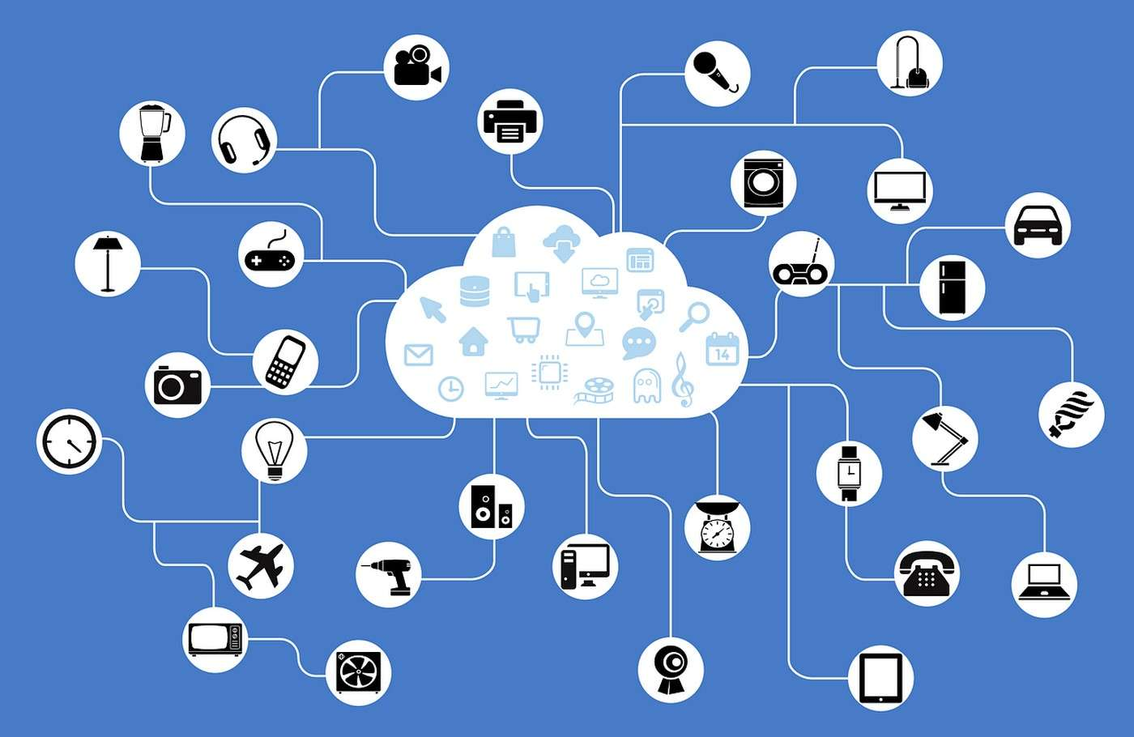
What is Internet of Things

Slide 41
Thank you

